Slide 1
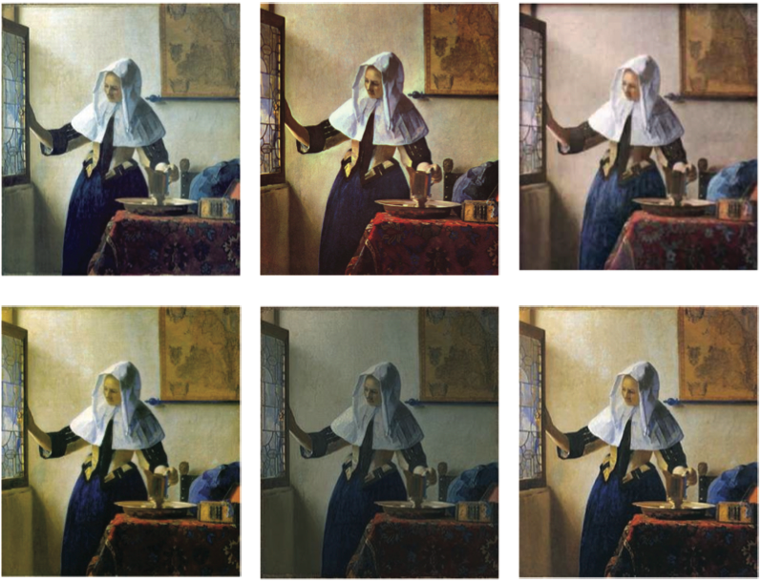
Measuring and Monitoring
Cultural Heritage Digital Image Quality
Don Williams
- Image Science Associates -
d.williams@imagescienceassociates.com

Slide 2
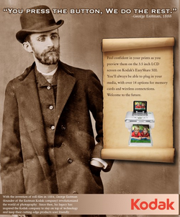
Why makes cultural heritage
imaging different ?
Future Re-purposing
  Variety of use cases
  Information durability
Information critical
  Images, not pictures
Scientific and
research component
High volume, High speed
  Think manufacturing
  Think error management

Slide 3
What you’ll see
Background
  Space + Light = Image
  Image Digitization
Digitization hardware components
Vocabulary
Performance Metrics - Signal & Noise
  Tone, White Balance, Color
  Resolution
  Noise
  Artifacts
Workflow Monitoring
Test plans

Slide 4
What is an image ?
A Spatial Map of Energy*
for our purpose
A two dimensional mapping of light energy ( red, green, blue, lightness)
Space and Light
* Applies to 3D, UV, IR, other colors too

Slide 5
What is Digitization?
Conversion (capture) of analog information in any form (text, photos, voice, etc.) to a digitally encoded form. This encoded information can be easily processed, stored, and transmitted through circuits, equipment and networks.
The encoded information can then be decoded into a surrogate analog form. (display)

Slide 6
What is a Digitized Image ?
- general imaging steps -
Interpret &
Render
Display
Or
Print
Object
Digitize
raw
Digitize
Processed
_{CAPTURE}
Encode - Converting light to numbers
_{DISPLAY}
Decode - Converting numbers to light
_{“The Digital Image”}
_{An encoded proxy image}

Slide 7
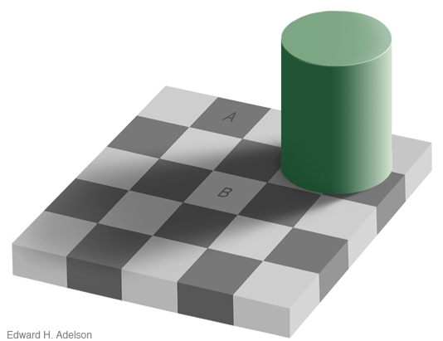
Why Visual Assessments
of Color and Tone can be unreliable

Slide 8
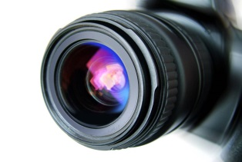
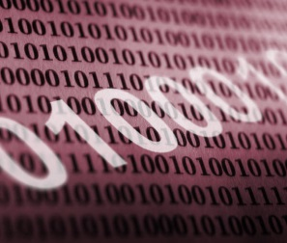
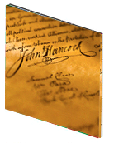
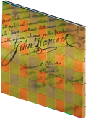
What is a Digital Imaging System?
( for capture)
The different ways an image is modified at capture
light
source
Image
forming
optics
_{Processing}
sample
sensor
_{Digital image file}
The performance of a digital capture system at the sensor and beyond is influenced by all of the above in addition to operator training and environment.

Slide 9
Digital Imaging Science -101
Light hits object
Object responds
Response is delivered
Delivery is digitized
What has changed ?

Slide 10
Digital Imaging Science -101
Light hits object
Object responds
Response is delivered
Delivery is digitized
What has changed ?

Slide 11
How is the Reflectance / Transmission of Objects Characterized ?
1000 units reflected
1000 units incident
= 1.000 reflectance
= 0.0 density
Incident
Illumination -
1000 units
100 units reflected
1000 units incident
= 0.100 reflectance
= 1.0 density
10 units reflected
1000 units incident
= 0.010 reflectance
= 2.0 density
1 units reflected
1000 units incident
= 0.001 reflectance
= 3.0 density
Reflective
or
transmissive
hardcopy
Density = - log₁₀ (reflectance)
Like the Richter Scale for measuring earthquake magnitude, density is also a “log” based metric. Each unit change in density is a 10x change in the magnitude of light ( reflectance). Log based units are frequently used for gauging equal differences in perceived magnitude.

Slide 12
Digital Imaging Science -101
Light hits object
Object responds
Response is delivered
Delivery is digitized
What has changed ?

Slide 13
Know your Collection
- Typical density ranges ( think light ) for collection content -
_{B&W Photographic Paper}
_{B&W Photographic Film}
_{Kodachrome film}
_{Color photographic paper}
_{Q-13 target}
_{Munsell papers}
_{Motion picture print film}
Non Photographic reflective material
_{Density}

Slide 14
Digital Imaging Science -101
Light hits object
Object responds
Response is delivered
Delivery is digitized
What has changed ?

Slide 15
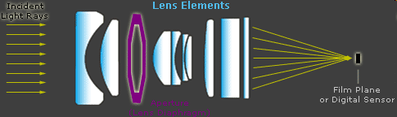
The Lens
The most important item affecting resolution in a camera
http://www.cambridgeincolour.com/tutorials/camera-lenses.htm
Aperture (F-number) extremes tend to produce the worse results
Higher F-numbers increase depth of focus but resolution suffers
Lower F-numbers tend to perform better but suffer from artifacts
Always inspect for color misregistration at corners of the field of view
Some lenses (telecentric design) are optimized for digital cameras
Zoom lenses are convenient but suffer from design compromises.

Slide 16
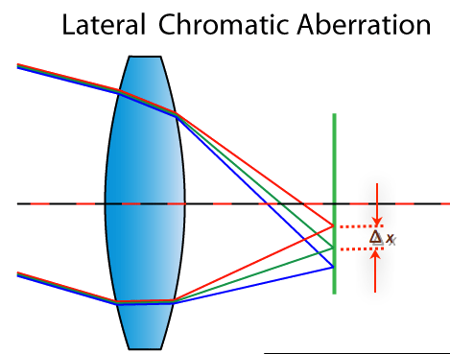
Color MisRegistration
- color focus shift-

Slide 17
Types of Digital Capture Systems
- Scanners vs. Cameras -
Fully Integrated – all capture components combined into a single plug-and-play scanner unit
  Flatbed scanners – Epson ($), Creo IQSmart3 ($$$)
  Copy Stand – Zeutschel, I2S products,
  Special Purpose - Kirtas, Treventus, and Qidenus
D-I-Y Copy stands ( i.e. camera-on-a-stick)
  Camera Backs – Betterlight, Hasselblad, Sinar, Phase One
  Digital SLRs – Canon EOS, Nikon

Slide 18
Sensor / Detector Technologies
What is the least expensive way to quickly capture
large amounts of high quality color image information ?
( cost ,speed, volume, quality)
Single detector or one detector for each color – flying spot scanners, drum scanners.
Linear arrays – one dimensional ordered arrangement of single detectors
Area arrays – two dimensional ordered arrangement of single detectors.
Step and Repeat (Macro or Micro) area strategy – capture and combine several area captures into a single large image

Slide 19
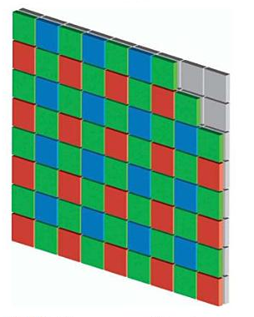
2-D Area Arrays
- Color Filter Array (CFA) pattern -
Three filter mosaic pattern ( Red, Green, Blue) of sensors. Sometimes other patterns are used but the “Bayer” pattern ( shown here) is by far the most popular. Used in virtually all consumer and professional digital cameras
One shot /one layer, sparsely populated color capture. Fully populated color achieved by interpolation algorithms (de-mosaicing) or micro-stepping.
Color filters integrated onto the sensor chip at manufacturing.
Occasionally will have subtle checkerboard artifacts or color aliasing rainbows in final delivered image.
From : The Focal encyclopedia of photography

Slide 20
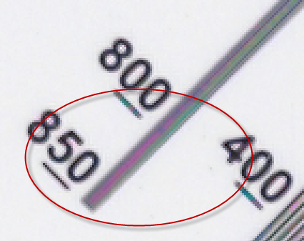
Rainbow artifacts from CFA reconstruction
Usually occurs with fine spaced repetitive patterns
- fabrics, engravings, halftones, target features -
Due to the inability of the processing algorithm to
accurately estimate the missing color pixels of a CFA

Slide 21
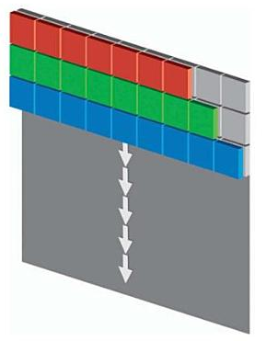
Linear Arrays ( Tri-linear)
Three filtered ( Red, Green, Blue) rows of sensors
The sensor stares at the object in the row dimension and scans by the object in other direction. Sometimes called a pushbroom.
Used in scan back cameras and sheet fed scanners. ( e.g. BetterLight, PhaseOne FX,), flatbed scanners and most film scanners.
Frequently have different performance behaviors in the two different directions.
Frequent streaking artifacts
From : The Focal encyclopedia of photography

Slide 22
Digital Imaging Science -101
Light hits object
Object responds
Response is delivered
Delivery is digitized
What has changed ?

Slide 23
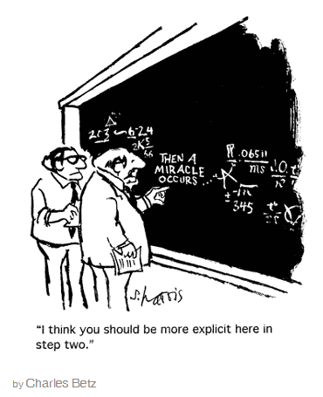
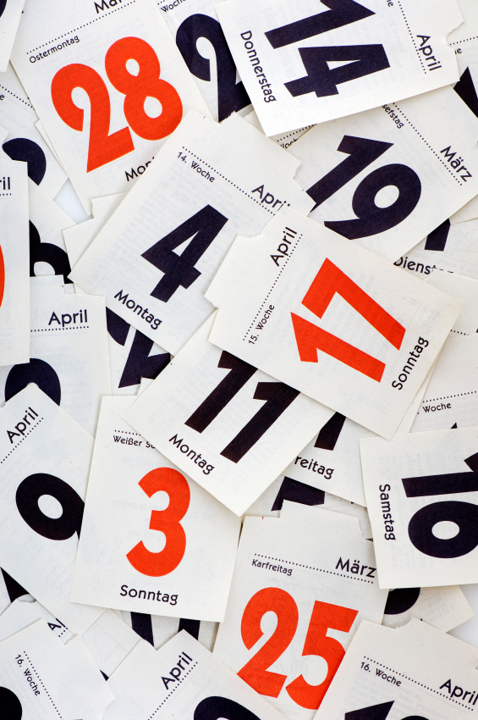


Then a miracle occurs !
→
→
Light → electricity → numbers
Bit Depth - Light intensities reaching the detector are assigned one of 2^{N} digital count values for each of M color channels. For high quality re-purposeable images N= 14-16 bits and M=3 color (RGB) channels. This is referred to as N bit quantization.
2⁸ = 256 values ( 0-255) : 2¹⁶ = 65536 values (0-65535)

Slide 24
N bits – M Channels
Raw or Safety Master image files are often delivered as 16 bit/channel or a total of 48 bit color. These files are often maintained as digital or safety masters because they allow maximum future utility.
2^{(16*3)} = 65536 levels for each of three colors. 48 bit color
More commonly, a scanner’s or camera’s software will use the higher number of bits to provide a “delivered file” of lesser number of bits that is consistent with a user’s specific application. Future utility of this finished file is compromised though.
₂¹ = 2 levels ( 0-1 ) one bit or bi-tonal image
₂⁸ = 256 levels ( 0-255 ) 8 bit or grayscale image
₂ ^{(8*3)} = 256 levels for each of three colors. True or 24 bit color.

Slide 25
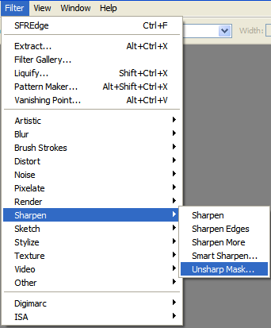
Image Processing
- the brains -
Image processing functions will affect imaging performance measurements. These include,
  Image resizing, rotation
  Sharpening
  Tone/Color adjustments
  Color profile changes
  Noise reduction
Two approaches for performance measurement
  Practice - measure the “as delivered” image file consistent with workflow practices.
  Benchmarking – measure the raw image file with as many functions as possible disabled.

Slide 26
Digital Imaging Science -101
Light hits object
Object responds
Response is delivered
Delivery is digitized
What has changed ?

Slide 27
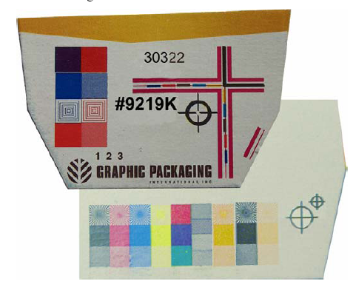
-Targets - a requirement for disposable dog biscuit packaging

Slide 28
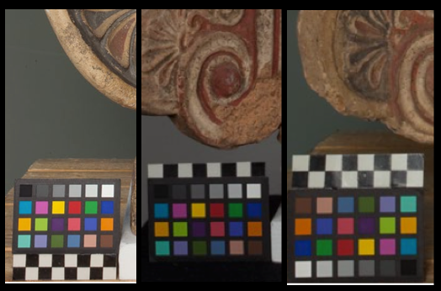
Targets as Jewelry ?

Slide 29
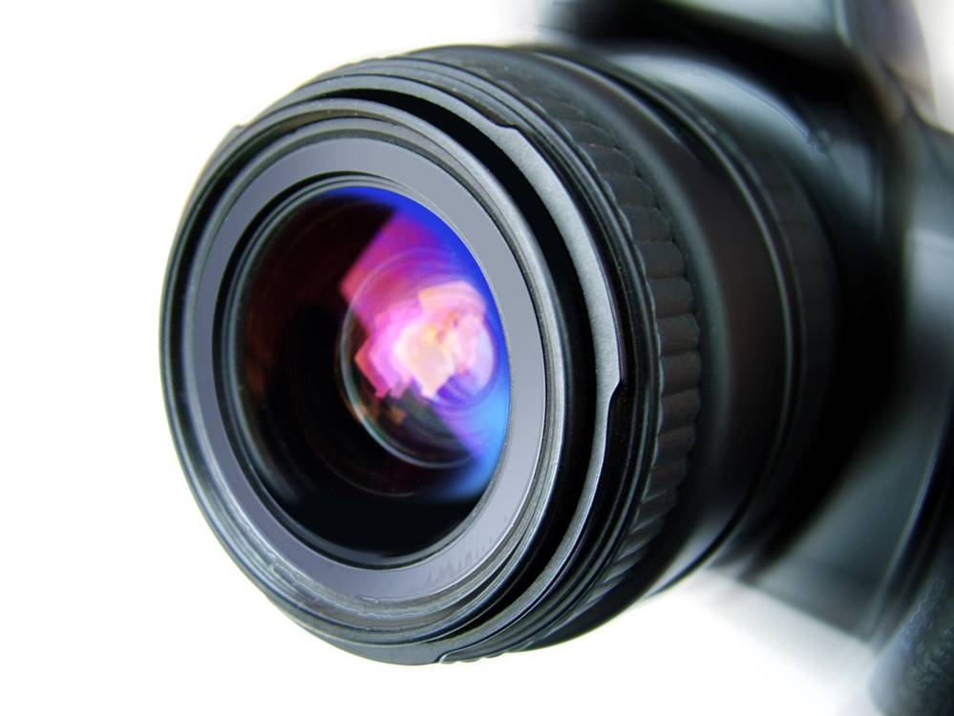
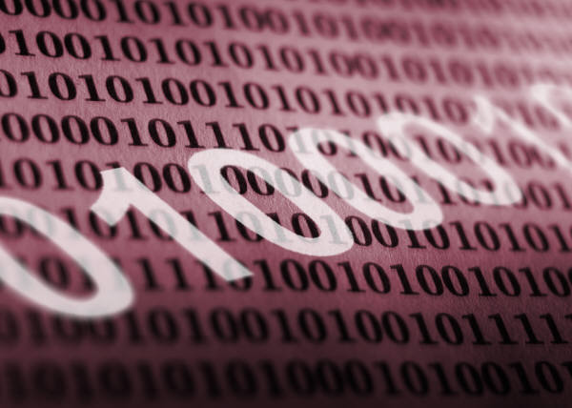
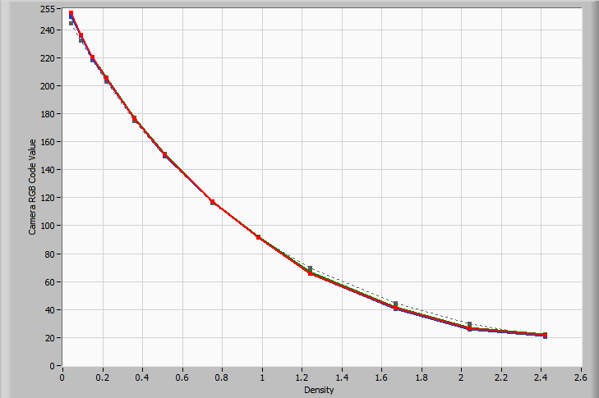


Targets
- Health checks for detecting imaging ills-
- Act as ground truth for before / after evaluation -
light
source
_{User Interface & Processing}
Image
forming
optics
sample
sensor
_{Digital image file}
Targets and Performance
Analysis Software

Slide 30
How metrics are used to measure performance ?
Accuracy - Image values from a target are compared with established aim values. These values are typically use-case dependent.
variation
Precision - Tolerances around these aims are also provided. Small tolerances imply greater precision but also higher production costs. The opposite is true for large tolerances.
Aim – The point or set of points intended to be hit
bias
Consistent performance is often more important than accuracy.

Slide 31
Capability vs. Performance
Capability
Behavior under optimal conditions
Performance
Behavior in actual use

Slide 32
Where FADGI fits in
FADGI provides quantitative guidelines on accuracy and precision levels for creating a durable, re-purposeable digital image object
Use case dependent
ISO based metrics
precision rating
Measures of goodness
10 years of learning

Slide 33
Why you should care
Quality control and industry compliance
Consistent product
Managing expectations – acceptance testing
Accurate Metadata population
Diagnostics – problem solving and image processing identification. Less rework.
Effective communication

Slide 34
Image Speak - Vocabulary
- staying dry in a storm of performance idioms -
Acutance
Geometric Distortion
Lateral Color
Error
White
Balance
Depth of
field
Wobble
Sharpness
Shading
Delta E
Exposure
Sharpening
Gamma
Exposure
Noise
Flare
Aliasing
Dynamic
Range
Resolution
Signal
Noise

Slide 35

Imaging Performance Framework
How terminology and metrics are organized
Foundation Metrics | Primary Metrics | Derivative Metrics
Signal | Tone Transfer Function Opto-Electronic Conversion Function (Large Area Signal ) | Tone / Exposure
 |  | White Balance
 |  | Gamma
 |  | Color / Delta E
 | Spatial Frequency Response (Small Area Signal ) | Resolution
 |  | Sharpening
 |  | Sampling Efficiency
Noise | Light Intensity Distortions | Random / White Noise
 |  | Banding / Streaking
 |  | Vignetting / Shading
 |  | Defects
 | Geometric Distortions Artifacts | Chromatic Aberration
 |  | Pincushion / Barrel
 |  | Aliasing / Moire

Slide 36
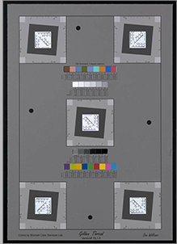
Device Target Elements
ISO Frequency Response (SFR) and resolution over the field of view. (7” x 10”)
Human interpretable resolution features
Dimensional scales for to confirm “dpi” levels
Automated feature detection
Neutral gray uniform background
Self described colorimetric patch annotations
Ten spectrally neutral gray patches

Slide 37

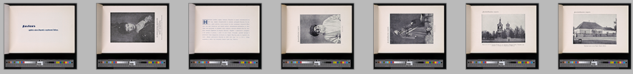
Object Target Elements
• Concise version of the device target.
• Enables 100% quality control.
• Calibrated spatial & colorimetric ground truth
to original object ( Think sustainability )
• Same features as device target
- SFR and Resolution
- Spectrally neutral grayscales
- Dimensional scales
- Automated feature detection
- Self described colorimetry

Slide 38
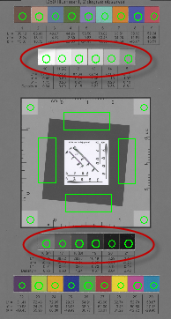
Graphical Representation of OECF
OECF example
250
200
150
average green count value ( 8 bit)
100
50
0
0
0.5
1
1.5
2
_{Density}
neutral (gray) density

Slide 39
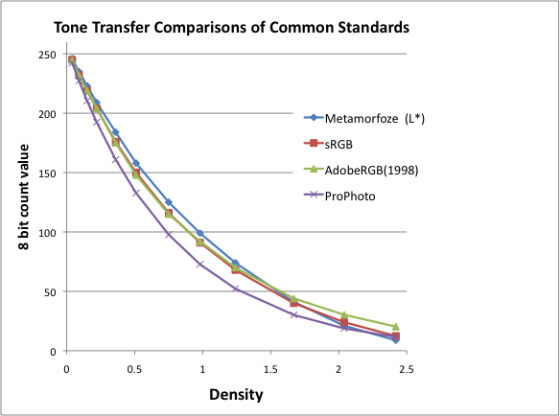
Tone transfer aim comparisons

Slide 40
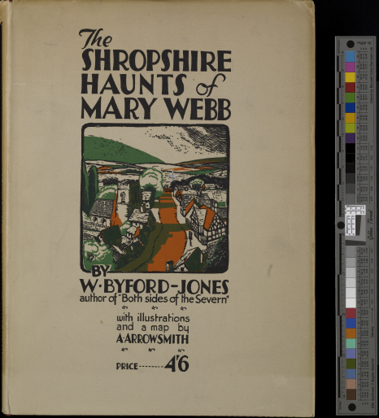
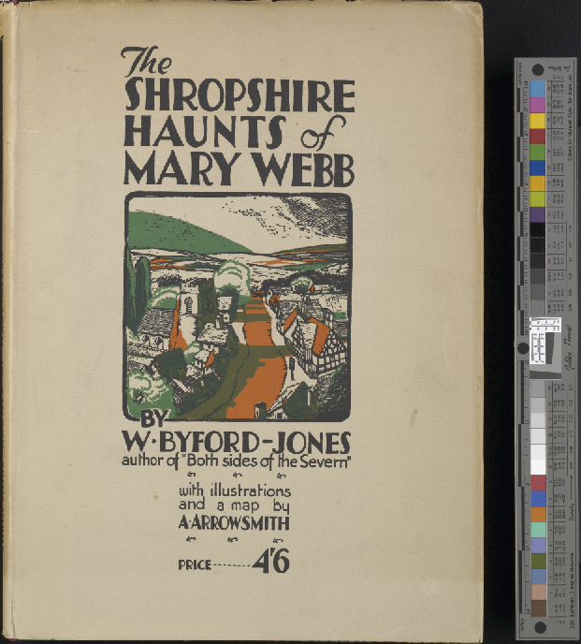
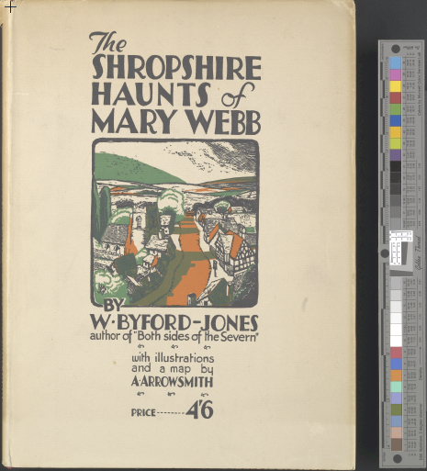
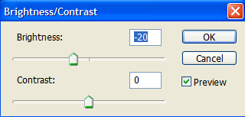
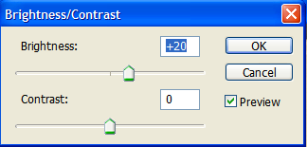
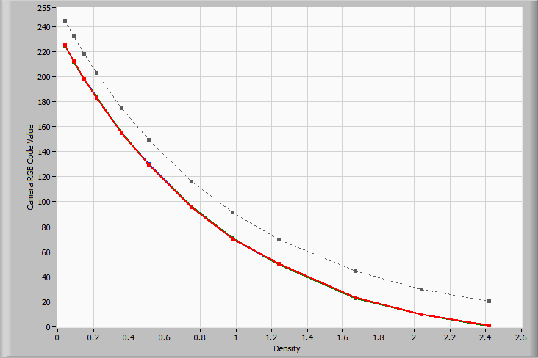
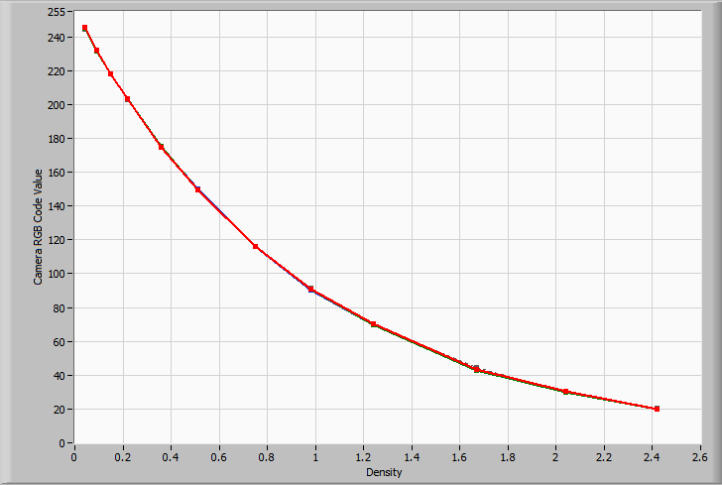
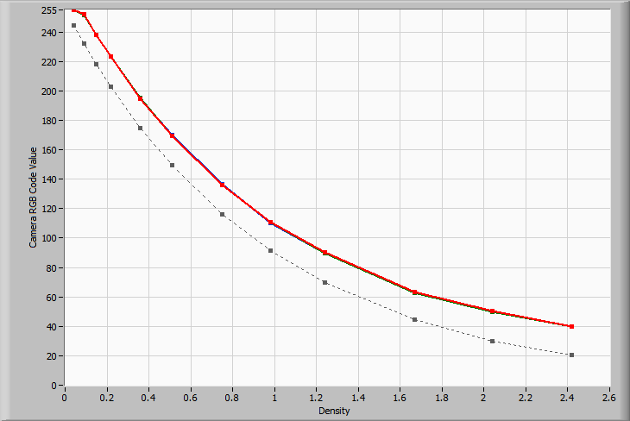
PShop Brightness adjustment effect on OECF
Under-exposed
Gamma 2.2 aim
Over-exposed

Slide 41
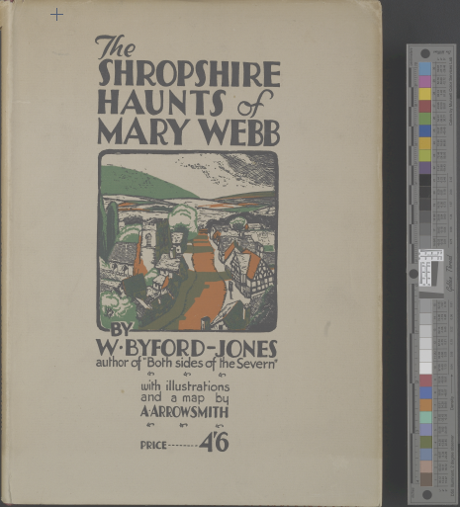
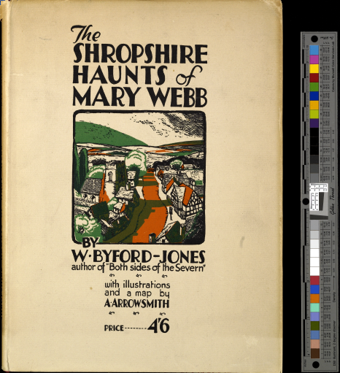
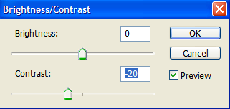
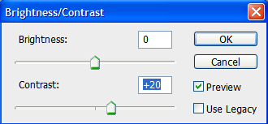
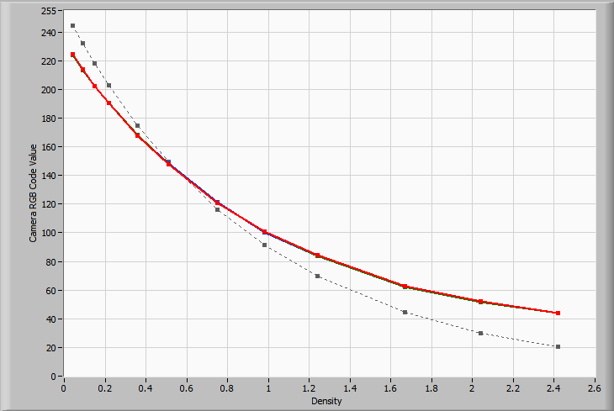
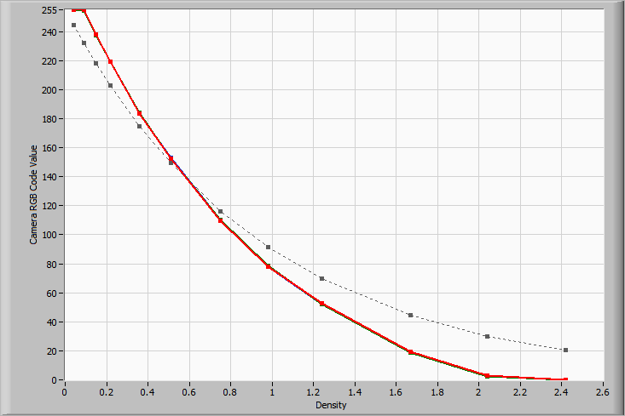
PShop contrast adjustment effect on OECF
Under-exposed ?
Gamma 2.2 aim
Over-exposed ?

Slide 42
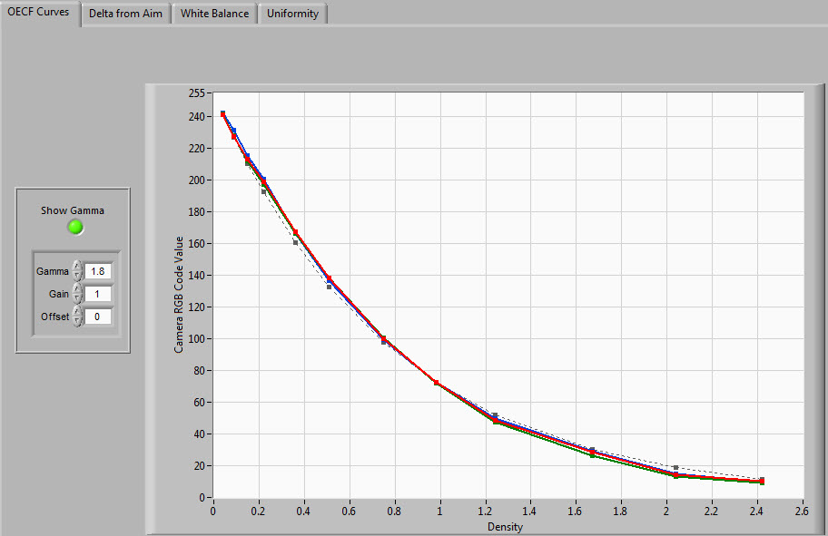
Tone Response –
key points
What to look for !
Avoid
clipping – horizontal plateaus
S - shaped curves
Achieve
- Monotonic, gamma shaped curves
- Count level coverage
- RGB grouping
- Aim vs. Actual curve

Slide 43
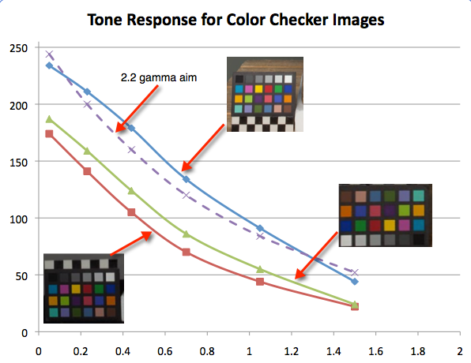
Targets alone are not sufficient
- They need to be analyzed and used -

Slide 44
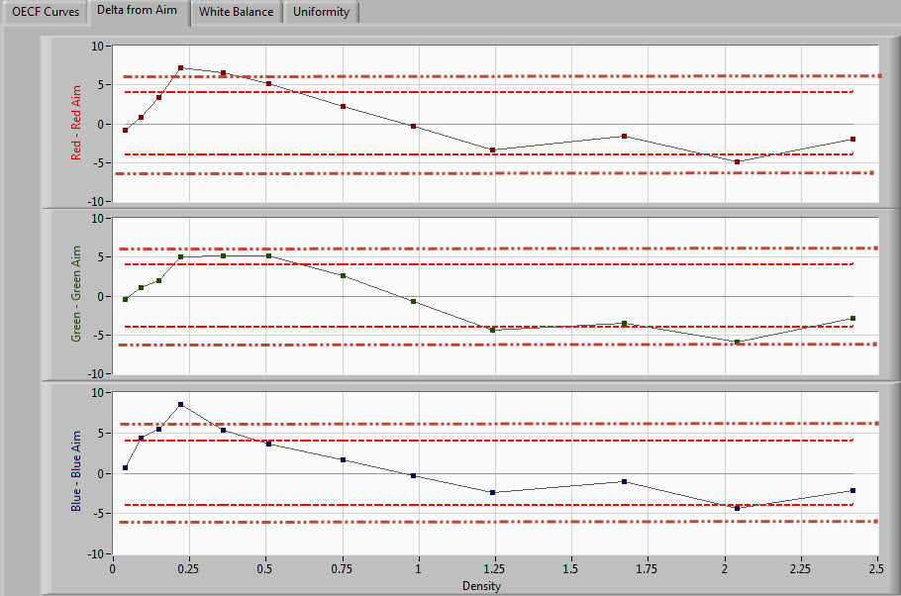
Exposure - Difference from aim
Tolerance corridor
★★★★
★★★

Slide 45
What causes OECFs to vary?
Non-standardized software selections
Confusing software driver settings
Individual color/tone preferences
Auto contrast selections
Lighting variability

Slide 46
White Balance
 OECFs can be measured for each color channel
using a target’s neutral gray patches.
 85% of good color imaging performance is keeping
the Red, Green, and Blue OECFs the same… Really!
This is a good example of a well white balanced capture
Note that all color channel OECFs lie on top of each other

Slide 47
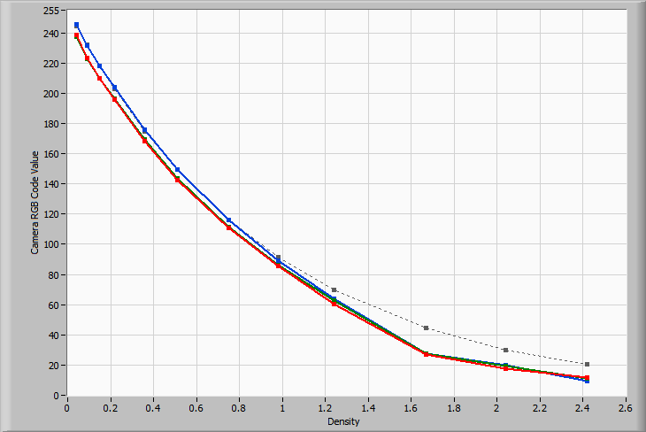
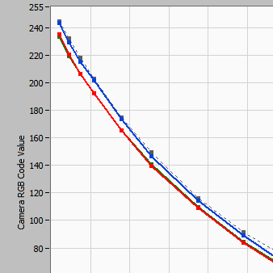
White Balance (full scale)
This is an example where the white balance performance is marginal.
Note how the blue channel OECF departs from the red and green OECF

Slide 48
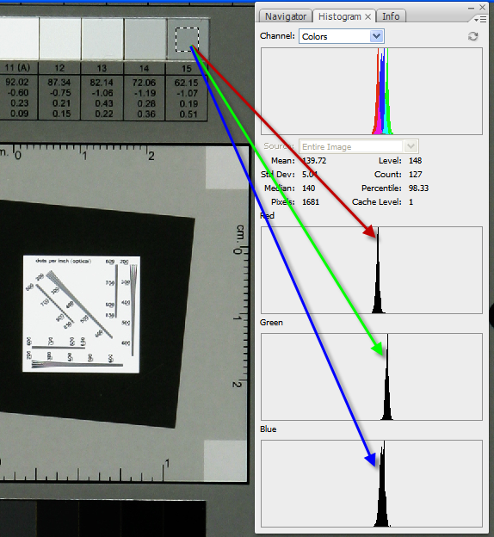
_{White Balance Assessment using}
_{Photoshop Histograms}
Though gray patches appear gray, the one patch is actually slightly colored.
All three histogram should align if white balance is correct

Slide 49
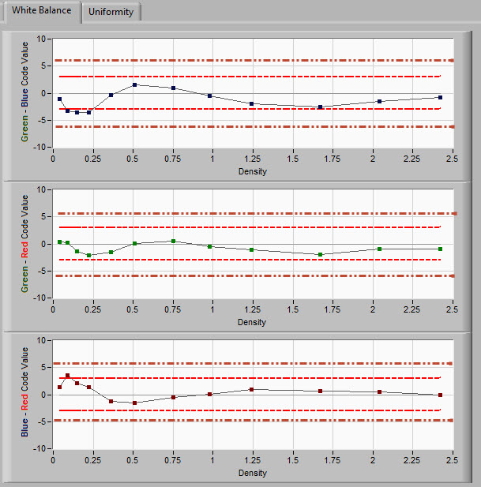
White Balance
- Keep the Neutrals neutral -
★★★
★★★★

Slide 50
Color
Colour
Kolor

Slide 51
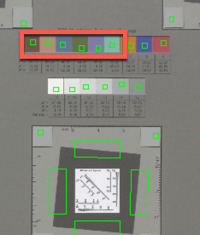




_{Color – Its just an encoding}
Same colors – different encoding
_{Courtesy of}
L*a*b*
color
Digital
encoded
color
Input color profiles are RGB code value to real color dictionaries

Slide 52
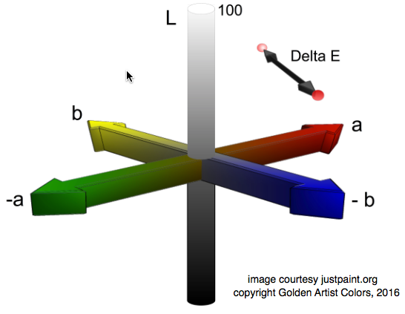
L*a*b*: A way to measure a single color
- A 3-D space that contains all possible colors perceived by human observers
- Uses color Lightness ( L*) and Hue/Saturation ( a*,b*) as parameters

Slide 53
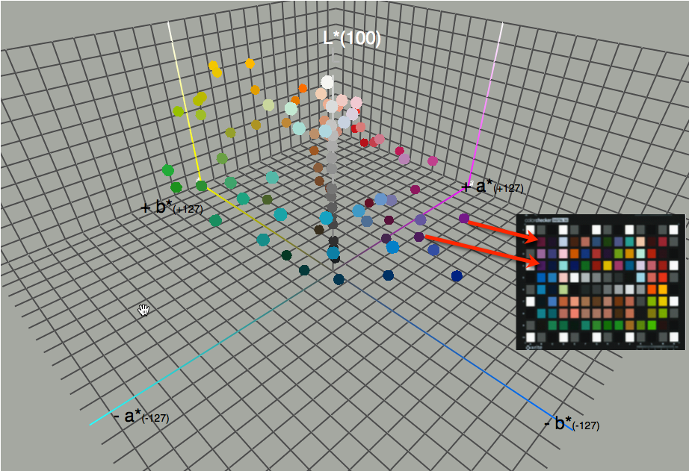
Color locations of a color calibration chart

Slide 54
Measuring digital color goodness
with Delta E
(written as ΔE)
Δ = Difference
E = Empfindung ( sensation)
A metric for measuring human perceived
color differences, or errors, between two colors
- Uses 3 color components (L*a*b*) to measure differences.
- Several refinements (1976,1994, 2000)
- Assumes certain viewing conditions
- Meant for small differences

Slide 55
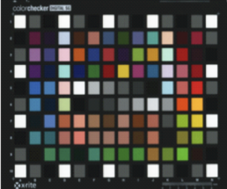
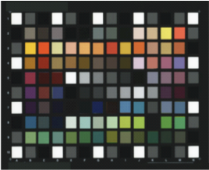
How ΔE₂₀₀₀ is calculated for digital capture
(L*a*b*)
Calculate ΔE₂₀₀₀ for each individual patch
Known L*a*b* values of
a measured color chart
Present ΔE₂₀₀₀ statistics for all patches
Calculate the average
RGB value for
each patch
Convert average RGB values into L*a*b* values via an explicit or assumed ICC color profile
RGB⌘ image of color chart
⌘RGB does NOT describe color
Notes:
Analogous to CONTROL Treatment

Slide 56


ΔE₂₀₀₀ statistics for all patches

Slide 57
Spatial Frequency Response
Foundation Metrics | Primary Metrics | Derivative Metrics
Signal | Tone Transfer Function Opto-Electronic Conversion Function (Large Area Signal ) | Tone / Exposure
 |  | White Balance
 |  | Gamma
 |  | Color / Delta E
 | Spatial Frequency Response (Small Area Signal ) | Resolution
 |  | Sharpening
 |  | Sampling Efficiency
Noise | Light Intensity Distortions | Random / White Noise
 |  | Banding / Streaking
 |  | Vignetting / Shading
 |  | Defects
 | Geometric Distortions | Chromatic Aberration
 |  | Pincushion / Barrel
 |  | Aliasing / Moire

Slide 58




Resolution example
- Hubble Space Telescope -
Same sampling frequency
and pixel count
Different spot size
Different resolution
Before lens modification
After lens modification

Slide 59

SFR & Resolution target features

Slide 60
Spatial Resolution
Two factors in a digital imaging system dictate the level of spatial resolution or detail that can ultimately be captured.
  Quantity; sampling frequency ( i.e. samples per mm, inch )
    Sets the maximum capability limit that can be realistically achieved.
  Quality; effective optical quality
    Defines the level of “blur” that the imaging optics, environmental factors, hardware, and image processing impose on the captured image.
  These are necessary but insufficient components, by themselves, for capturing spatial detail. Simply improving one to reconcile deficiencies in the other will not enhance real resolution performance.

Slide 61



Spatial Frequency Response (SFR)-
The relative change in contrast of increasingly finer spatial features
SFR or ( MTF)
Increasing spatial frequency
Lens
Increasing spatial frequency
Imaged
Test
Pattern
Imaged
Light
Distribution
Test Pattern

Slide 62

SFR & Resolution -> Quality of data (information)
Increasing lines/inch
(line width = 1/200 “)
(line width = 1/300 “)
(line width = 1/400 “)

Slide 63

When are 5 lines clearly distinguishable ?
Quality
Quantity

Slide 64
Calculating Sampling Efficiency
Quality (optical limit)
Adopt an accepted optical criteria for limiting resolution.
e.g. 10% SFR frequency
Quantity (digital limit)
Determine where this criteria falls relative to
the theoretical limit for digital capture
Sampling Efficiency =
Measured Optical Limit
Theoretical Digital Limit
0 %
50 %
100 %

Slide 65
Calculating Sampling Efficiency
SFR for digital print scanner
at different sampling frequencies
1
0.9
0.8
0.7
SFR
0.6
0.5
0.4
0.3
0.2
0.1
0
0
50
100
150
200
250
300
spatial frequency (dpi)
250 ppi
300 ppi
500 ppi
Sampling Efficiency =
Measured Optical Limit (200)
= 66%
Theoretical Digital Limit (300)

Slide 66
Flatbed scanner using a linear array
_{Max. measurable frequency}
_{at 600 dpi sampling}
fast
slow
The horizontal (slow) scan direction SFRs are lower due to the motion of the linear
array in the scanner. The duplicate edges in both directions measure the same

Slide 67
FADGI Sampling Efficiency criteria
★★★★ : ≥ 90%
★★★ : ≥ 80%
★★ : ≥ 70%
★ : ≥ 60%

Slide 68
SFR – Their shapes and interpretations
Sharpened
1.0
Normal
Low contrast - Flare
SFR response
0.5
Limiting resolution will generally
correspond to the spatial frequency having a 0.10 modulation transfer value
0.0
Increasing spatial frequency. Finer detail

Slide 69
Why limiting resolution (10%) alone
fails to predict quality
& why the SFR is better for doing so.

Slide 70

SFR results- ideal curves

Slide 71

Sharpness vs. Resolution
Sharpness
Resolution

Slide 72

Reproduction Scale Accuracy
Does Header Data match the Actual data ?
Does the Requested Data match the Actual ? data ?

Slide 73
FADGI Scale Accuracy Criteria (2017)
★★★★ : ≤ 1.0% difference
★★★ : ≤ 2.0% difference
★★ : ≤ 3.0% difference
★ : ≤ 4.0% difference

Slide 74
SFR diagnostics
- Camera shake
mirror up/down
during strobe
- Floor shake
- F-number too high
- Focal plane /platen not parallel
Bad lenses
Image processing

Slide 75
Noise - Light
Foundation Metrics | Primary Metrics | Derivative Metrics
Signal | Tone Transfer Function Opto-Electronic Conversion Function (Large Area Signal ) | Tone / Exposure
 |  | White Balance
 |  | Gamma
 |  | Color / Delta E
 | Spatial Frequency Response (Small Area Signal ) | Resolution
 |  | Sharpening
 |  | Sampling Efficiency
Noise | Light Intensity Distortions | Random / White Noise
 |  | Banding / Streaking
 |  | Vignetting / Shading
 |  | Defects
 | Geometric Distortions Artifacts | Chromatic Aberration
 |  | Pincushion / Barrel
 |  | Aliasing / Moire

Slide 76


Two Forms of Random Noise
Fine-grain noise ->
high frequency fluctuations
Course-grain noise ->
low frequency fluctuations
Both of these images have the same amount of total noise

Slide 77

One-dimensional random noise
- banding and streaking -
• Often found on devices using linear arrays
• Contrast and equalize enhancements are
useful in detecting such noise behaviors
Following contrast enhancement

Slide 78

Scanner Noise Characterization
Instead of calculating the average count value
for each neutral patch region, the standard deviation
of the count values is calculated and plotted instead

Slide 79
A few words on image noise
• Noise values above 5 count values should be monitored closely.
• Noise values less than 0.5 may be due to clipping or aggressive noise cleaning
• High ISO speed values yield noisier images
• Sharpening tend to increase noise levels
• Noise cleaning software should be used cautiously. If applied too aggressively it will mistake object texture for random noise and remove the texture in the photographed object.

Slide 80
Noise - Light
Foundation Metrics | Primary Metrics | Derivative Metrics
Signal | Tone Transfer Function Opto-Electronic Conversion Function (Large Area Signal ) | Tone / Exposure
 |  | White Balance
 |  | Gamma
 |  | Color / Delta E
 | Spatial Frequency Response (Small Area Signal ) | Resolution
 |  | Sharpening
 |  | Sampling Efficiency
Noise | Light Intensity Distortions | Random / White Noise
 |  | Banding / Streaking
 |  | Vignetting / Shading
 |  | Defects
 | Geometric Distortions Artifacts | Chromatic Aberration
 |  | Pincushion / Barrel
 |  | Aliasing / Moire

Slide 81
Artifacts : Look at Images
Some imaging behavior defies objective measurement…for the time being.
  De-texturing
  Checker boarding
  Localized geometric distortions
  Sensor defects
  Color aliasing
Many are technology specific. Just knowing what type of scanner technology was used allows one to prepare for certain artifacts.

Slide 82

Visual Inspection for Artifacts
_{Color Misregistration}

Slide 83


Visual Inspection for Artifacts
Bad Cam in a Linear array scanner

Slide 84

Visual Inspection for Artifacts
Visual assessments of spatial artifacts is quite reliable
resolution limit due to CFA de-mosaicing
optical resolution limit

Slide 85

Spatial Artifacts
Large Format Linear Array Scanner

Slide 86

Streaking in a linear array scanner

Slide 87

Interpolation Artifacts
4 – shot checkerboard artifact

Slide 88

Zipper Artifacts
Crop from a good 3 star
scan, but….
Poor color interpolation

Slide 89
So Far
Let the numbers guide
but not dictate.
Tools really do work.
But…always take a look

Slide 90
Don’t forget
Capability
Behavior under optimal conditions
Performance
Behavior in actual use

Slide 91
Scan, but Verify
Performance Monitoring
  Things vary, things go wrong
  … at transitions
  … sometimes randomly
  … mostly human and
  environmental causes

Slide 92

- Performance Monitoring - OECF
_{Book Scanner Example}

Slide 93


Performance Monitoring – OECF four-day holiday syndrome

Slide 94



Slide 95
Test plans
Test both “null” and processed ( delivered ) image files.
Explore and evaluate the image for artifacts, especially at edge transitions and on highly structured target features.
  Color misregistration
  Wavy or scalloped edges
  Near image perimeter
  moiré patterns on halftones ( view at 100%)
Have an acceptance test plan for expensive purchases.
  300, 400, 600, 800 dpi series
  On-site testing by your operators
  Evaluate over entire field of view.
  Archive test plan images for future reference and comparisons
Except for artifacts, use numbers not visual impressions as evidence.

Slide 96

End
1907 autochrome

